Slide 1
The four-step approach to the groundswell
P
People
Assess your customers’ social activities
O
Objectives
Decide what you want to accomplish
S
Strategy
Plan for how relationships with customers will change
T
Technology
Decide which social technologies to use

Slide 2
The Social Technographics Ladder
18%
25%
12%
25%
48%
44%
Publish a blog
Publish your own Web pages
Upload video you created
Upload audio/music you created
Write articles or stories and post them
Creators
Post ratings/reviews of products/services
Comment on someone else’s blog
Contribute to online forums
Contribute to/edit articles in a wiki
Critics
Use RSS feeds
Add “tags” to Web pages or photos
“Vote” for Web sites online
Collectors
Joiners
Maintain profile on a social networking site
Visit social networking sites
Profile your
customers at
groundswell.forrester.com
Read blogs
Watch video from other users
Listen to podcasts
Read online forums
Read customer ratings/reviews
Spectators
Base: US online adults
Source: Forrester Q2 2007
Social Technographics Survey
Inactives
None of the above
Groups include people participating in at least
one of the activities monthly.

Slide 3
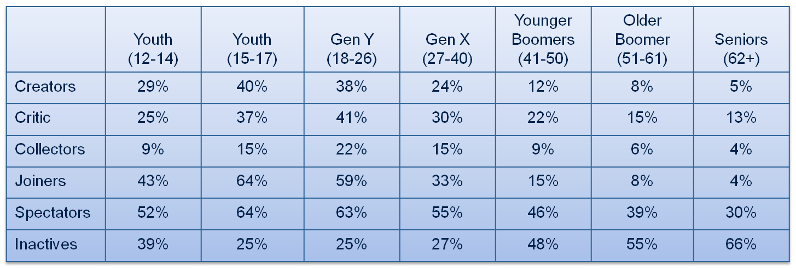
Age is also a major driver of adoption
Percent of each generation in each Social Technographics category
Base: US online consumers
Source: NACTAS Q2 2007 North American Social Technographics online survey
NACTAS Q4 2007 Youth online survey

Slide 4

The Social Technographics profile of Alpha Moms
Index
Online adults = 100
57
105
85
86
112
93
Base: US online adults
Source: North American Social Technographics® Online Survey, Q2 2007
Notes:
Index online adults = 100

Slide 5

Thank you
Charlene Li
+1 650.581.3833
cli@forrester.com
Visit our site at
groundswell.forrester.com

